Slide 1
EJRC
Environmental Justice Resource Center
Transportation Justice

Slide 2
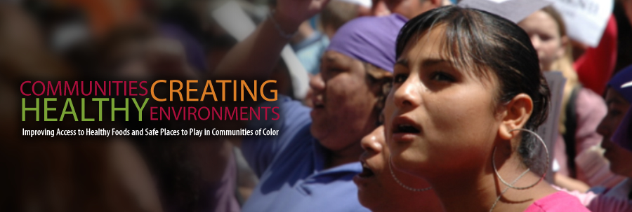
Transportation Justice
Presenters
Angel O. Torres M.C.P., Environmental Justice Resources Center
Glenn S. Johnson Ph.D., Environmental Justice Resources Center
Moderator: Ditra Edwards, Program Director, The Praxis Project

Slide 3
Basic Logistics
Please mute your phone
The session will be recorded
Process for Q &A
The chat box
Resources, including recording of webinar, will be available after the webinar on CCHEonline.org

Slide 4
Webinar Overview
Background on Transportation Equity
Brief Overview of Transit Justice
Addressing Transit Racism
Transportation Bill
Transportation Planning
Transit Investments
Distribution of Transportation Benefits and Burdens
Environmental & Social Costs of Sprawl
Role of Public Involvement
Question and Answers

Slide 5
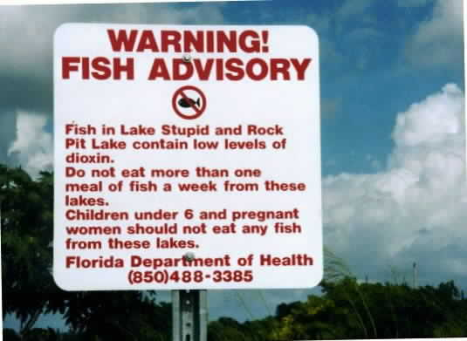
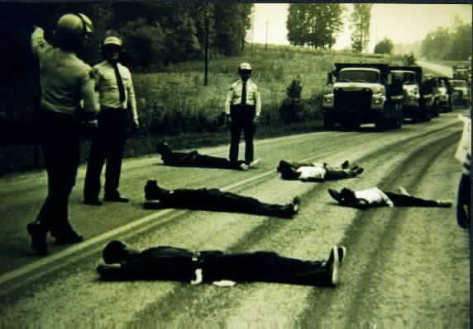
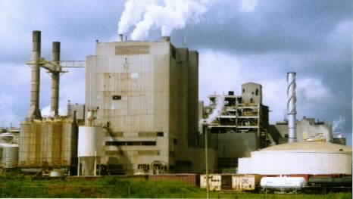
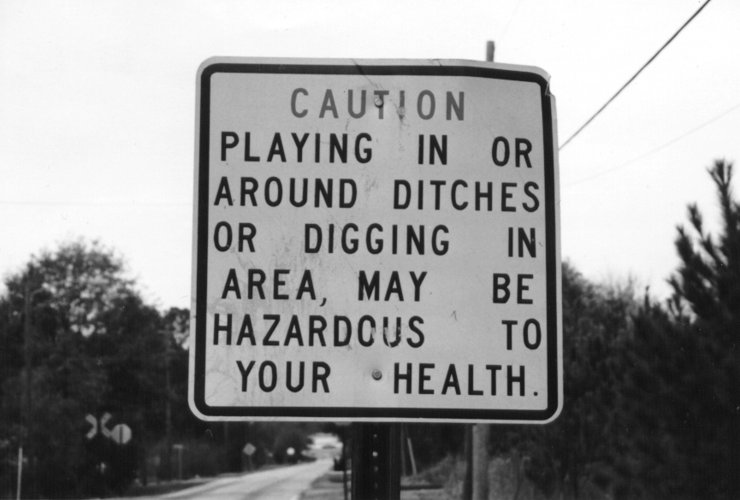
Environmental Justice Principle
Environmental justice embraces the principle that all people and communities are entitled to equal protection of our environmental, health, employment, education, housing, transportation, and civil rights laws

Slide 6
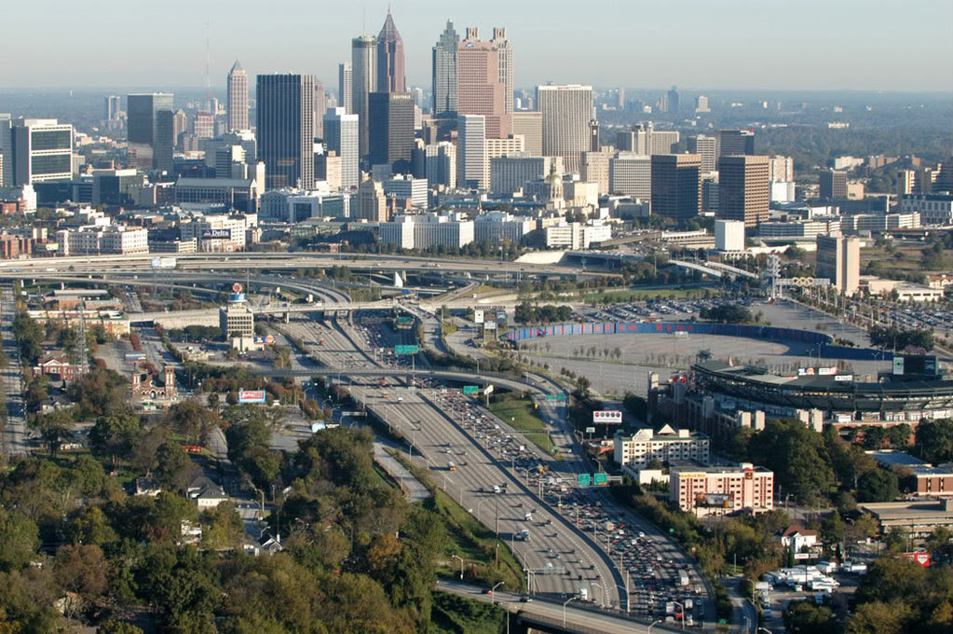
Today’s Transportation
Intersects civil rights, economics & environment
Influences economic mobility, sustainability & human interaction
Impacts poverty, unemployment, & access to education, health care & other public services

Slide 7
Importance of Transportation
Transportation touches every aspect of our lives – where we live, work, play, and go to school
Transportation plays a pivotal role in shaping human interaction, economic mobility, and sustainability
Transportation also provides access to opportunity and serves as a key component in addressing poverty, unemployment, and equal opportunity goals while ensuring access to education, health care, and other public services

Slide 8
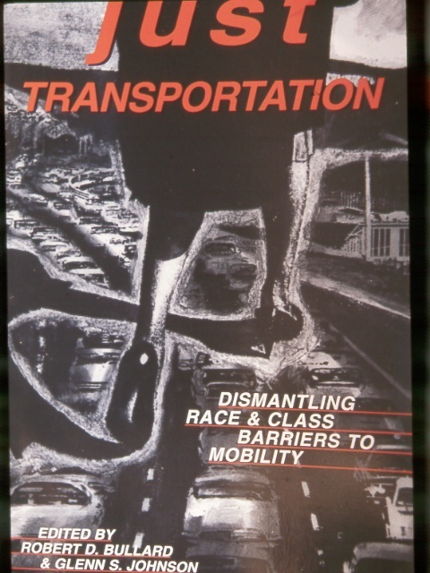
Transportation Equity
American society is largely divided between those with car and those without cars—a form of transportation apartheid
Transportation is a major component in emergency preparedness, evacuation, and reconstruction
Nationally, 7 percent of white households own no car, compared with 24 percent of black households, 17 percent of Latino households, and 13 percent of Asian-American households

Slide 9
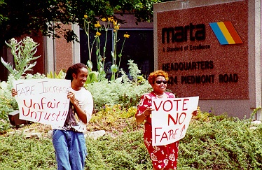
Transportation Equity
Procedural Equity (Is the process fair, uniform, and consistent?)
Geographic Equity (Are some spatial communities located on the “wrong side of the tracks?”)
Social Equity (How are the benefits and costs distributed among population groups?)

Slide 10
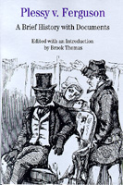
Dismantling Separate But Equal
Transportation and Civil Rights have been linked for more than a century
The 1896 U.S. Supreme Court Plessy v. Ferguson decision codified “Jim Crow” segregation

Slide 11
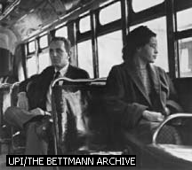
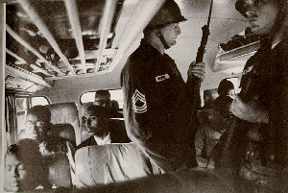
Assault on Transportation Apartheid
U.S. Supreme Court overturned Plessy in 1954 Brown v. Board of Education of Topeka
The system was later challenged by Rosa Parks in 1955 and Montgomery Boycott
Freedom Riders placed their young lives on the line in the early 1960s

Slide 12
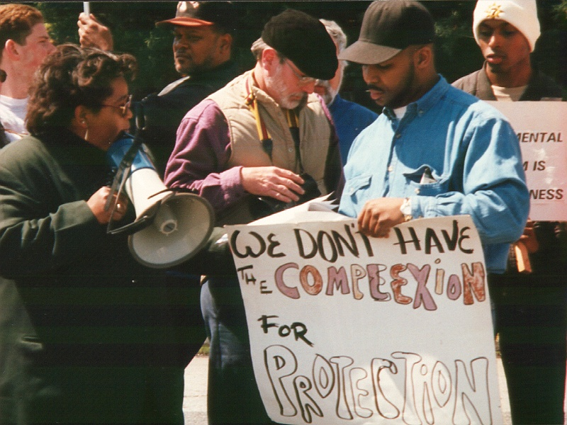
Title VI of the Civil Rights Act of 1964
“No person in the United States shall, on the ground of race, color, or national origin, be excluded from participation in, be denied the benefits of, or be subjected to discrimination under any program or activity receiving federal financial assistance”

Slide 13
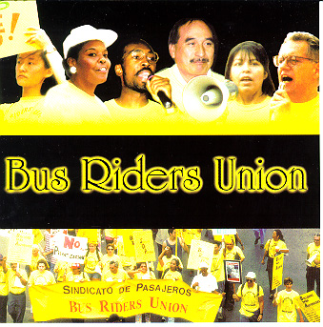
Confronting Transit Racism in the U.S.
Grassroots groups from New York to California are challenging transit racism and other transportation policies that aid and abet the flight of people, jobs, and investments to the suburban fringe
In 1996, the LA Bus Riders Union won a $1.5 billion dollar Title VI Civil Rights settlement against the Los Angeles MTA and set a national model for grassroots transit organizing, advocacy, litigation, and policy formulation

Slide 14
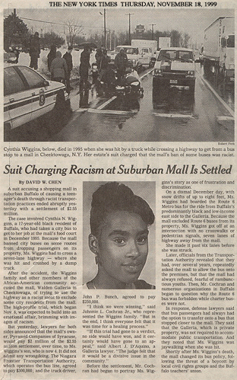
Transit Racism Can Kill
Transit discrimination killed 17-year old Cynthia Wiggins because Buffalo city buses were not allowed to stop at an upscale suburban mall
The transit discrimination lawsuit was settled in November, 1999 for $2.55 million

Slide 15
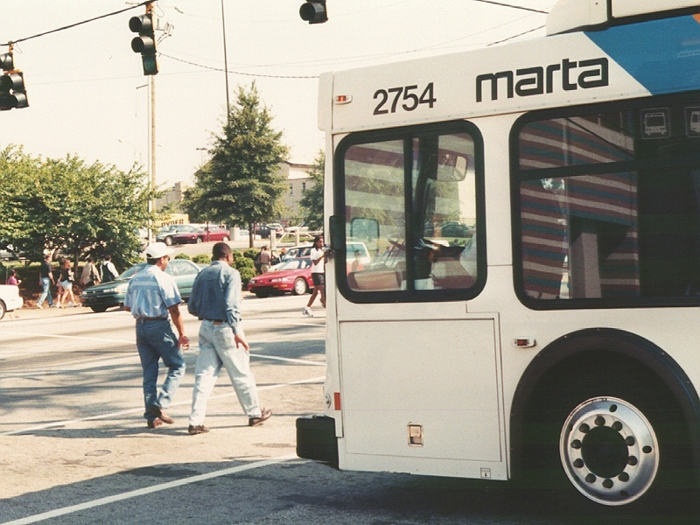
MARTA – “Moving Africans Rapidly Through Atlanta”
The Metropolitan Atlanta Rapid Transit Authority (MARTA) was conceived as a five-county system in the 1960s
However, the mostly white suburban counties opted out and several later created their own “separate and unequal” suburban bus systems

Slide 16
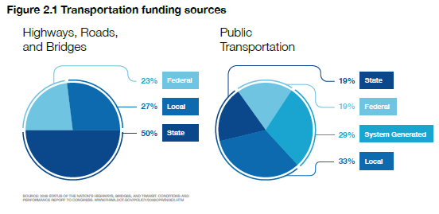
Transportation Bill
The current Federal Transportation Bill, "The Safe, Accountable, Flexible, Efficient, Transportation Equity Act” or SAFETEA-LU was enacted in Aug. 2005.
SAFETEA-LU authorized $286.4 billion for federal transportation programs for highways, transit, and bicycles and pedestrians for a 5-year period, 2005-2009.

Slide 17
Webinar Overview
Transportation Planning
Transit Investments
Distribution of Transportation Benefits and Burdens
Environmental & Social Costs of Sprawl
Role of Public Involvement
Question and Answers

Slide 18
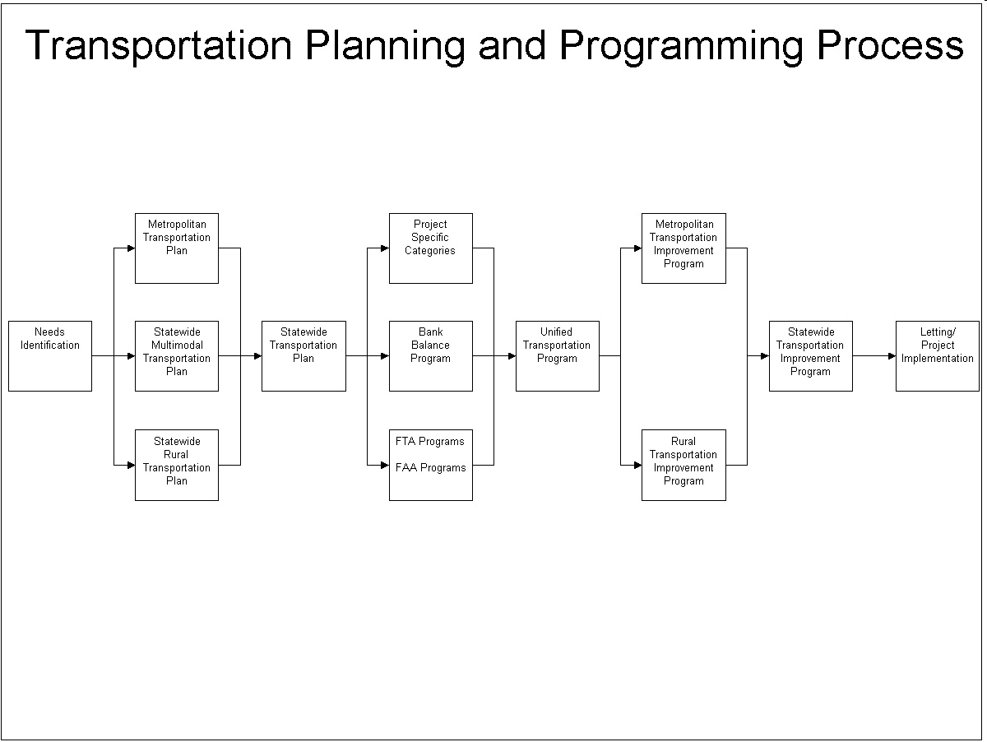

Slide 19
Transportation Planning Process
Document | Who Develops? | Who Approves? | Time/Horizon | Content | Update Requirements
UWUP | MPO | MPO | 1 or 2 Years | Planning Studies and Tasks | Annually
MTP | MPO | MPO | 20 Years | Future Goals, Strategies and Projects | Every 5 Years (4 years for non-attainment and maintenance areas)
TIP | MPO | MPO/Governor | 4 Years | Transportation Investments | Every 4 Years
LRTP | State DOT | State DOT | 20 Years | Future Goals, Strategies and Projects | Not Specified
STIP | State DOT | US DOT | 4 Years | Transportation Investments | Every 4 Years
UWUP: The Unified Planning Work Program
MTP: Metropolitan Transportation Plan
TIP: Transportation Improvement Program
LRTP: Long-Range Transportation Plan
STIP: Statewide Transportation Improvement Program

Slide 20
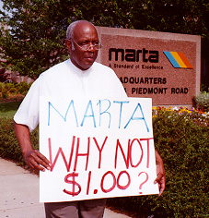
Transit Investments
All transit is not created equal
Some communities get buses, others get light rail, while some are left out altogether
Transit equity analysis uses the “follow the dollars” approach

Slide 21
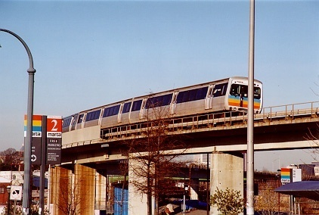
Getting There on Public Transportation
Nationally, only about 5 percent of all Americans use public transit to get to work
In urban areas, African Americans and Latinos comprise over 54 percent of transit users, mostly bus riders
African Americans are almost six times as likely as whites to use transit to get around

Slide 22
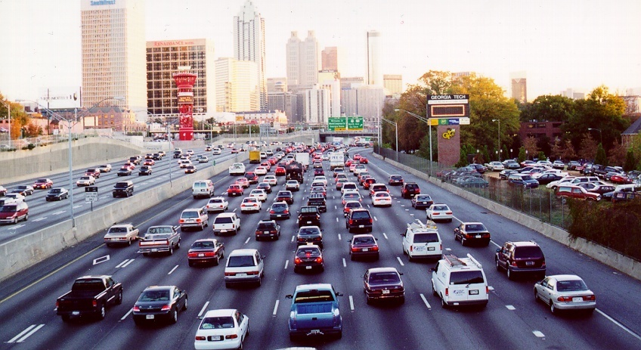
The Price of Gridlock
Heavy dependence on automobiles adds to the traffic and air pollution problems, threatens public health and wastes money and energy
Transportation sources account for 80% of carbon monoxide, 45% of nitrogen oxide, 35% of hydrocarbons, 32% of carbon dioxide, 19% of particulate matter, and 5% of sulfur dioxide

Slide 23
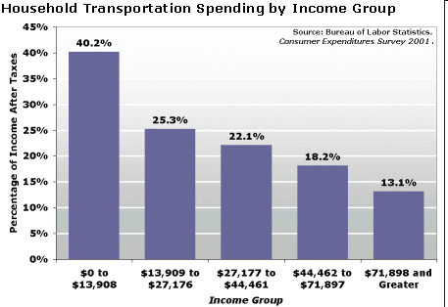
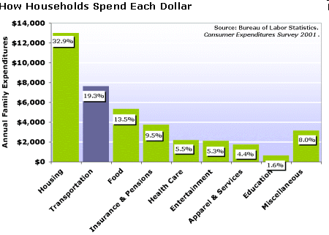
Driven to Spend
On average, Americans spend 19 cents out of every dollar earned on transportation expenses
Transportation costs ranged from 17.1 percent in the Northeast to 20.8 percent in the South
Americans spend more on transportation than they do on food, education, and health care
The nation’s poorest families spend more than 40 percent of their take home pay on transportation

Slide 24
Follow the Dollars
Public transit has received roughly $50 billion since the creation of the Urban Mass Transit Administration over thirty years ago, while roadway projects have received over $205 billion since 1956
Generally, states spend less than 20 percent of federal transportation funding on transit
Just 6 percent of all federal highway dollars are sub-allocated directly to the metropolitan regions

Slide 25
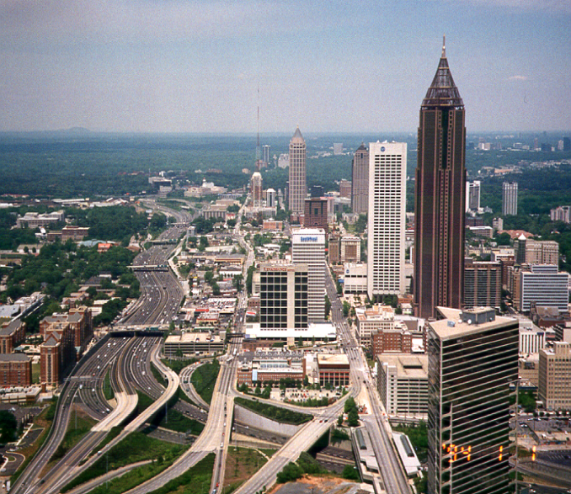
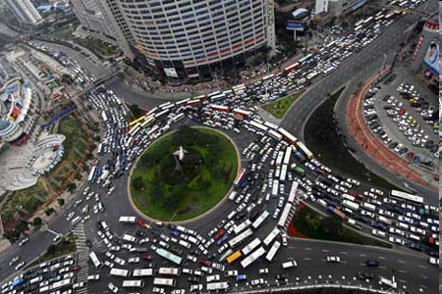
Shortchanging Metro Areas
Commuters in 176 metro regions paid $20 billion more in federal gas tax than they received in federal highway trust fund money for both transit and highways from 1998 through 2003
Taxpayers in 54 metro areas lost over $100 million dollars the six year period
The top gas tax losers were Los Angeles, Dallas-Fort Worth, Phoenix, Atlanta, Detroit, and New Orleans
Such an uneven playing field creates “donor regions”

Slide 26
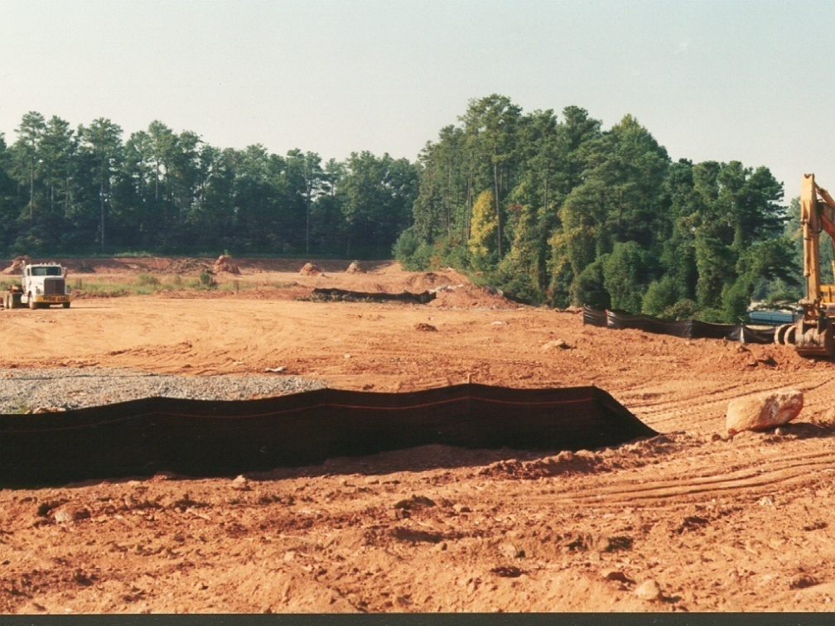
Overlooking Rural Areas
Transportation systems are inadequate, out-dated, and underfunded
Public transportation enhances rural economic growth (employment, education, stores, health care, social and recreational opportunities, and other community resources)
Many rural areas lack transportation infrastructure (i.e. proper roads, sidewalks, curbs, etc...)
Highway investment patterns allow drivers to travel quickly through rural areas. Road construction has bypassed smaller towns, affecting business districts in the small towns

Slide 27
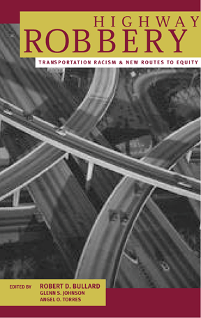
Highway Robbery
From 1998-2003, transportation spending amounted to over $217 billion
Some 30 states restrict use of the gas tax revenue to funding highways only
Between fiscal year 1992 and 1999, states had more than $33.8 billion in federal funds available to spend on either highways or public transportation, but spent only 12.5% of that sum on public transit

Slide 28
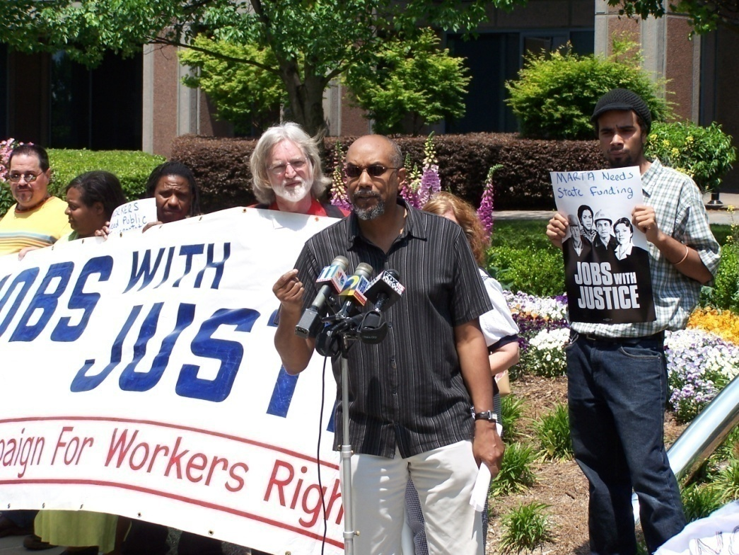
Spatial Mismatch and Opportunity
Only 21 percent of employees in the top 98 metro areas work within three miles of downtown, while over twice that share (45 percent) work more than 10 miles away from the city center
Employment steadily decentralized between 1998 and 2006: 95 out of 98 metro areas saw a decrease in the share of jobs located within three miles of downtown.
In almost every major industry, jobs shifted away from the city center between 1998 and 2006

Slide 29
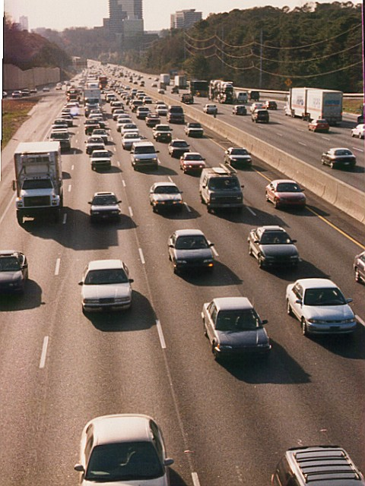
Cars vs. Mass Transit
Every 1% increase in highway capacity generates a 0.9% increase in traffic within five years
Using a car for a five-mile commute annually releases 110 pounds of carbon monoxide pollution into the air
Using a train for the same commute releases only 2.4 ounces of the carbon monoxide per passenger

Slide 30
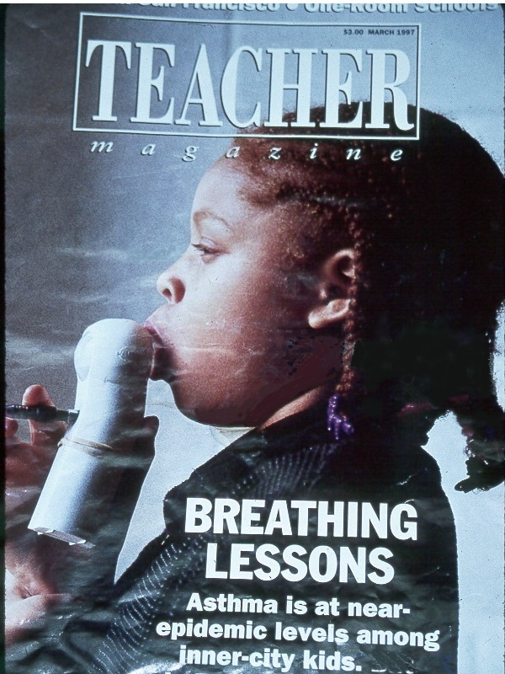
Transportation and Health
African Americans are three to six times more likely than whites to die from asthma
Hispanics are three times more likely than whites to die from asthma
Asthma is the number one reason for childhood emergency room visits

Slide 31
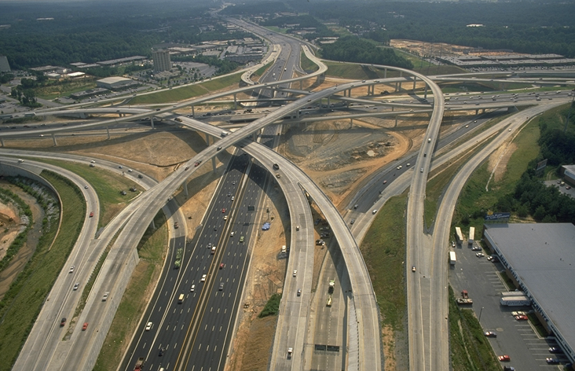
Environmental Costs of Sprawl
Water Pollution
Air Pollution
Loss of Green Space
Heat Island and Thunder Storms
Wasted Energy
Flooding
Congestion and Gridlock
Urban Infrastructure Decline

Slide 32
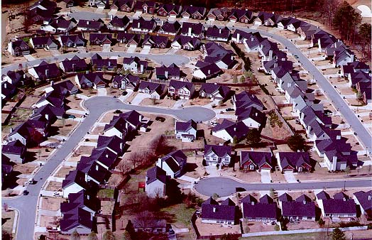
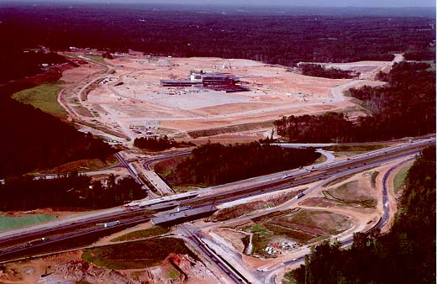
Social Costs of Sprawl
Urban Abandonment
Limited Access to Jobs
Decreased Mobility
Barriers to Fair Housing
Segregation
Concentration of Poverty
Urban-Suburban School Disparities
Public Health

Slide 33
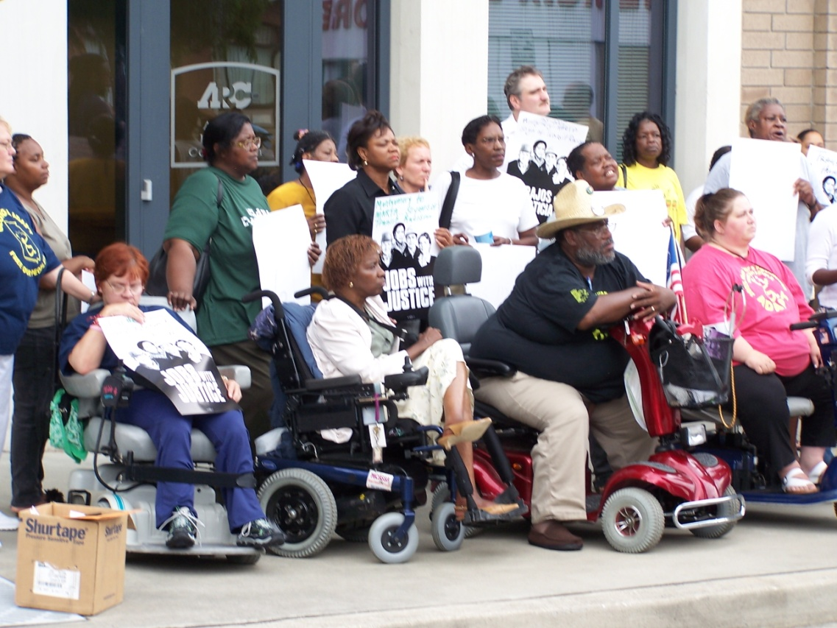
Public Involvement Opportunities
Voices: People of Color, Students, People with Disabilities
Coalitions: housing, education, health, transportation experts, environmentalists, civil rights advocates, economic development, equity networks, & grassroots organizers
Transportation is a Basic Civil Right

Slide 34
Successful EJ Practices
The Fruitvale community in Oakland illustrates several effective environmental justice practices, including public involvement; the creation of partnerships to overcome legal, financial, and regulatory hurdles; and the use of mass transit as a lever for revitalizing an urban community.
South Park Avenue Improvement Project in Tucson, Arizona demonstrates an effective use of partnerships to leverage funds for transportation enhancements in a EJ community; it also illustrates the use of context-sensitive design as a tool for reawakening a community's sense of identity and pride.
In 2001, WE ACT successfully filed a complaint with the U.S. Department of Transportation alleging that diesel bus depots were disproportionately located in Manhattan’s minority communities. They co-filed the complaint showing that the high number of bus depots in northern Manhattan violated Title VI of the Civil Rights Act of 1964.
In October of 1996, the BRU won a landmark civil rights Consent Decree, following the class action civil rights lawsuit brought against the Los Angeles MTA in 1994. The case, Labor/Community Strategy Center and Bus Riders Union et al. v. Los Angeles County Metropolitan Transportation Authority. The consent decree included Fare reduction, Reduction of bus overcrowding, New Service to major centers of employment, education and healthcare throughout the county, and a Joint Working Group (joint BRU and MTA policy making body that oversees the implementation of the Consent Decree).

Slide 35
QUESTIONS
AND
ANSWERS

Slide 36
WWW.CCHEONLINE.ORG

